Slide 1
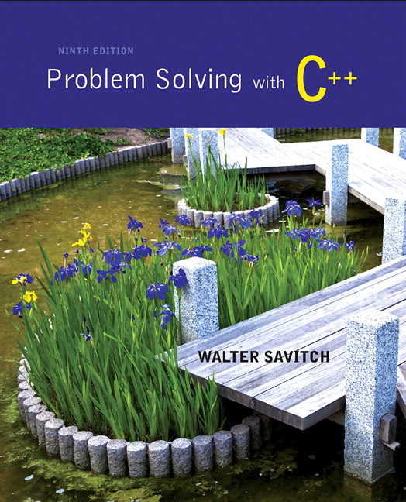
Problem Solving with C++ by Walter Savitch

Slide 2
Chapter 7
Arrays

Slide 3
Overview
7.1 Introduction to Arrays
7.2 Arrays in Functions
7.3 Programming with Arrays
7.4 Multidimensional Arrays

Slide 4
7.1
Introduction to Arrays

Slide 5
Introduction to Arrays
An array is used to process a collection of data of the same type
Examples: A list of names A list of temperatures
Why do we need arrays?
Imagine keeping track of 5 test scores, or 100, or 1000 in memory
How would you name all the variables?
How would you process each of the variables?

Slide 6
Declaring an Array
An array, named score, containing five variables of type int can be declared as int score[ 5 ];
This is like declaring 5 variables of type int: score[0], score[1], … , score[4]
The value in brackets is called
A subscript
An index

Slide 7
The Array Variables
The variables making up the array are referred to as
Indexed variables
Subscripted variables
Elements of the array
The number of indexed variables in an array is the declared size, or size, of the array
The largest index is one less than the size
The first index value is zero

Slide 8
Array Variable Types
An array can have indexed variables of any type
All indexed variables in an array are of the same type
This is the base type of the array
An indexed variable can be used anywhere an ordinary variable of the base type is used

Slide 9
Using [ ] With Arrays
In an array declaration, [ ]'s enclose the size of the array such as this array of 5 integers: int score [5];
When referring to one of the indexed variables, the [ ]'s enclose a number identifying one of the indexed variables
score[3] is one of the indexed variables
The value in the [ ]'s can be any expression that evaluates to one of the integers 0 to (size -1)

Slide 10
Indexed Variable Assignment
To assign a value to an indexed variable, use the assignment operator: int n = 2; score[n + 1] = 99;
In this example, variable score[3] is assigned 99

Slide 11
Loops And Arrays
for-loops are commonly used to step through arrays
Example: for (i = 0; i < 5; i++) { cout << score[i] << " off by " << (max – score[i]) << endl; } could display the difference between each score and the maximum score stored in an array
First index is 0
Last index is (size – 1)
Display 7.1

Slide 12
Constants and Arrays
Use constants to declare the size of an array
Using a constant allows your code to be easily altered for use on a smaller or larger set of data
Example: const int NUMBER_OF_STUDENTS = 50; int score[NUMBER_OF_STUDENTS]; … for ( i = 0; i < NUMBER_OF_STUDENTS; i++) cout << score[i] << " off by " << (max – score[i]) << endl;
Only the value of the constant must be changed to make this code work for any number of students

Slide 13
Variables and Declarations
Most compilers do not allow the use of a variable to declare the size of an array Example: cout << "Enter number of students: "; cin >> number; int score[number];
This code is illegal on many compilers
Later we will see dynamic arrays which supports this idea

Slide 14
Array Declaration Syntax
To declare an array, use the syntax: Type_Name Array_Name[Declared_Size];
Type_Name can be any type
Declared_Size can be a constant to make your program more versatile
Once declared, the array consists of the indexed variables: Array_Name[0] to Array_Name[Declared_Size -1]

Slide 15
Computer Memory
Computer memory consists of numbered locations called bytes
A byte's number is its address
A simple variable is stored in consecutive bytes
The number of bytes depends on the variable's type
A variable's address is the address of its first byte

Slide 16
Arrays and Memory
Declaring the array int a[6]
Reserves memory for six variables of type int
The variables are stored one after another
The address of a[0] is remembered
The addresses of the other indexed variables is not remembered
To determine the address of a[3]
Start at a[0]
Count past enough memory for three integers to find a[3]
Display 7.2

Slide 17
Array Index Out of Range
A common error is using a nonexistent index
Index values for int a[6] are the values 0 through 5
An index value not allowed by the array declaration is out of range
Using an out of range index value doe not produce an error message!

Slide 18
Out of Range Problems
If an array is declared as: int a[6]; and an integer is declared as: int i = 7;
Executing the statement a[i] = 238; causes…
The computer to calculate the address of the illegal a[7]
(This address could be where some other variable is stored)
The value 238 is stored at the address calculated for a[7]
No warning is given!

Slide 19
Initializing Arrays
To initialize an array when it is declared
The values for the indexed variables are enclosed in braces and separated by commas
Example: int children[3] = { 2, 12, 1 }; Is equivalent to: int children[3]; children[0] = 2; children[1] = 12; children[2] = 1;

Slide 20
Default Values
If too few values are listed in an initialization statement
The listed values are used to initialize the first of the indexed variables
The remaining indexed variables are initialized to a zero of the base type
Example: int a[10] = {5, 5}; initializes a[0] and a[1] to 5 and a[2] through a[9] to 0

Slide 21
Un-initialized Arrays
If no values are listed in the array declaration, some compilers will initialize each variable to a zero of the base type
DO NOT DEPEND ON THIS!

Slide 22
Range-Based For Loops
C++11 includes a new type of for loop, the range-based for loop, that simplifies iteration over every element in an array. The syntax is shown below:
for (datatype varname : array) { // varname is successively set to each
// element in the array }

Slide 23
Range-Based For Loop Example
The following code outputs 2 4 6 8
int arr[ ] = {2, 4, 6, 8};
for (int x : arr)
cout << x;
cout << endl;

Slide 24
Section 7.1 Conclusion
Can you
Describe the difference between a[4] and int a[5]?
Show the output of char symbol[3] = {'a', 'b', 'c'}; for (int index = 0; index < 3; index++) cout << symbol[index];

Slide 25
7.2
Arrays in Functions

Slide 26
Arrays in Functions
Indexed variables can be arguments to functions
Example: If a program contains these declarations: int i, n, a[10]; void my_function(int n);
Variables a[0] through a[9] are of type int, making these calls legal: my_function( a[ 0 ] ); my_function( a[ 3 ] ); my_function( a[ i ] );
Display 7.3

Slide 27
Arrays as Function Arguments
A formal parameter can be for an entire array
Such a parameter is called an array parameter
It is not a call-by-value parameter
It is not a call-by-reference parameter
Array parameters behave much like call-by-reference parameters

Slide 28
Array Parameter Declaration
An array parameter is indicated using empty brackets in the parameter list such as void fill_up(int a[ ], int size);

Slide 29
Function Calls With Arrays
If function fill_up is declared in this way: void fill_up(int a[ ], int size);
and array score is declared this way: int score[5], number_of_scores;
fill_up is called in this way: fill_up(score, number_of_scores);
Display 7.4

Slide 30
Function Call Details
A formal parameter is identified as an array parameter by the [ ]'s with no index expression void fill_up(int a[ ], int size);
An array argument does not use the [ ]'s fill_up(score, number_of_scores);

Slide 31
Array Formal Parameters
An array formal parameter is a placeholder for the argument
When an array is an argument in a function call, an action performed on the array parameter is performed on the array argument
The values of the indexed variables can be changed by the function

Slide 32
Array Argument Details
What does the computer know about an array?
The base type
The address of the first indexed variable
The number of indexed variables
What does a function know about an array argument?
The base type
The address of the first indexed variable

Slide 33
Array Parameter Considerations
Because a function does not know the size of an array argument…
The programmer should include a formal parameter that specifies the size of the array
The function can process arrays of various sizes
Function fill_up from Display 7.4 can be used to fill an array of any size: fill_up(score, 5); fill_up(time, 10);

Slide 34
const Modifier
Array parameters allow a function to change the values stored in the array argument
If a function should not change the values of the array argument, use the modifier const
An array parameter modified with const is a constant array parameter
Example: void show_the_world(const int a[ ], int size);

Slide 35
Using const With Arrays
If const is used to modify an array parameter:
const is used in both the function declaration and definition to modify the array parameter
The compiler will issue an error if you write code that changes the values stored in the array parameter

Slide 36
Function Calls and const
If a function with a constant array parameter calls another function using the const array parameter as an argument…
The called function must use a constant array parameter as a placeholder for the array
The compiler will issue an error if a function is called that does not have a const array parameter to accept the array argument

Slide 37
const Parameters Example
double compute_average(int a[ ], int size); void show_difference(const int a[ ], int size) { double average = compute_average(a, size); … }
compute_average has no constant array parameter
This code generates an error message because compute_average could change the array parameter

Slide 38
Returning An Array
Recall that functions can return a value of type int, double, char, …, or a class type
Functions cannot return arrays
We learn later how to return a pointer to an array

Slide 39
Case Study: Production Graph
Problem Definition:
We are writing a program for the Apex Plastic Spoon Company
The program will display a bar graph showing the production of each of four plants for a week
Each plant has separate records for each department
Input is entered plant by plant
Output shows one asterisk for each 1000 units, and production is rounded to the nearest 1,000 units

Slide 40
Analysis of The Problem
Use an array named production to hold total production of each plant
Production for plant n is stored in production[n-1]
Program must scale production to nearest 1,000 units to display asterisks in the bar

Slide 41
Production Graph Sub-Tasks
Analysis leads to the following sub-tasks
input_data: Read input for each plant Set production [plant_number -1]
to the total production for plant
number n
scale: For each plant, change production[plant_number] to the correct number of asterisks
graph: Output the bar graph

Slide 42
More Analysis Details
The entire array will be an argument for the functions we write to perform the subtasks
We will also include a formal parameter for the size
The size of the array is equal to the number of plants
We will use a constant for the number of plants
The function declarations and main function for the production graph program are found in
Display 7.5

Slide 43
Algorithm Design: input_data
We must read all departments' data for each plant and add them to produce a plant's total
Algorithm for input_data: for plant_number is 1, 2, …, last_plant_number do the following Read all the data for plant number plant_number Sum the numbers Set production[plant_number – 1] to the total

Slide 44
Coding input_data
The algorithm can be translated to C++ as: void input_data(int a [ ], int last_plant_number) { using namespace std; for (int plant_number = 1; plant_number <= last_plant_number; plant_number++) { cout << endl; << "Enter production for plant" << plant_number << endl; get_total( a[plant_number -1] ); } }

Slide 45
Testing input_data
Each function should be tested in a program in which it is the only untested function
Because input_data calls get_total, get_total is tested first
Once tested, get_total can be used to test input_data
Display 7.6 (1)
Display 7.6 (2)
Display 7.6 (3)

Slide 46
Test Data for input_data
Remember that input_data should be tested
With a plant that contains no production figures
With a plant having only one production figure
With a plant having more than one figure
With zero and non-zero production figures

Slide 47
Algorithm for scale
scale changes the value of the indexed variable to show the whole number of asterisks to print
Scale is called using scale (production, NUMBER_OF_PLANTS); and its algorithm is for (int index = 0; index < size; index++) Divide the value of a[index] by 1,000 and round the result to the nearest integer

Slide 48
Coding scale
The code for scale, below, uses a function named round that must be defined as well
void scale(int a[ ], int size) { for (int index = 0; index < size; index++) a[index] = round (a[index] / 1000.0); }
Why not 1000?

Slide 49
Function floor
Function round, called by scale, uses the floor function from the cmath library
The floor function returns the first whole number less than its argument: floor (3.4) returns 3 floor (3.9) returns 3
Adding 0.5 to the argument for floor is how round performs its task floor (3.4 + 0.5) returns 3 floor (3.9 + 0.5) returns 4

Slide 50
Testing scale
To test scale
First test round
Scale should be tested with arguments that
Are 0
Round up
Round down
Display 7.7 (1)
Display 7.7 (2)

Slide 51
Function graph
The design of graph is quite straightforward and not included here
The complete program to produce the bar graph is found in
Display 7.8 (1)
Display 7.8 (2)
Display 7.8 (3)
Display 7.8 (4)

Slide 52
Section 7.2 Conclusion
Can you
Write a function definition for a function called one_more, which has a formal parameter for an array of integers and increases the value of each array element by one. Are other formal parameters needed?

Slide 53
7.3
Programming with Arrays

Slide 54
Programming With Arrays
The size needed for an array is changeable
Often varies from one run of a program to another
Is often not known when the program is written
A common solution to the size problem
Declare the array size to be the largest that could be needed
Decide how to deal with partially filled arrays

Slide 55
Partially Filled Arrays
When using arrays that are partially filled
Functions dealing with the array may not need to know the declared size of the array, only how many elements are stored in the array
A parameter, number_used, may be sufficient to ensure that referenced index values are legal
A function such as fill_array in Display 7.9 needs to know the declared size of the array
Display 7.9 (1)
Display 7.9 (2)
Display 7.9 (3)

Slide 56
Constants as Arguments
When function fill_array (Display 7.9) is called, MAX_NUMBER_SCORES is used as an argument
Can't MAX_NUMBER_SCORES be used directly without making it an argument?
Using MAX_NUMBER_SCORES as an argument makes it clear that fill_array requires the array's declared size
This makes fill_array easier to be used in other programs

Slide 57
Searching Arrays
A sequential search is one way to search an array for a given value
Look at each element from first to last to see if the target value is equal to any of the array elements
The index of the target value can be returned to indicate where the value was found in the array
A value of -1 can be returned if the value was not found

Slide 58
The search Function
The search function of Display 7.10…
Uses a while loop to compare array elements to the target value
Sets a variable of type bool to true if the target value is found, ending the loop
Checks the boolean variable when the loop ends to see if the target value was found
Returns the index of the target value if found, otherwise returns -1
Display 7.10 (1)
Display 7.10 (2)

Slide 59
Program Example: Sorting an Array
Sorting a list of values is very common task
Create an alphabetical listing
Create a list of values in ascending order
Create a list of values in descending order
Many sorting algorithms exist
Some are very efficient
Some are easier to understand

Slide 60
Program Example: The Selection Sort Algorithm
When the sort is complete, the elements of the array are ordered such that a[0] < a[1] < … < a [ number_used -1]
This leads to an outline of an algorithm: for (int index = 0; index < number_used; index++) place the indexth smallest element in a[index]

Slide 61
Program Example: Sort Algorithm Development
One array is sufficient to do our sorting
Search for the smallest value in the array
Place this value in a[0], and place the value that was in a[0] in the location where the smallest was found
Starting at a[1], find the smallest remaining value swap it with the value currently in a[1]
Starting at a[2], continue the process until the array is sorted
Display 7.11
Display 7.12 (1-2)

Slide 62

Program Example: Bubble Sort
There are many sorting algorithms, another simple one is Bubble Sort
Idea is to bubble the largest value toward the end of the array by swapping consecutive elements
Initial array:
3, 10, 9, 2, 5
Compare 3 and 10; no swap since 10 is greater than 3

Slide 63
Program Example: Bubble Sort
3, 10, 9, 2, 5
Compare 10 and 9; swap since 10 is larger than 9
3, 9, 10, 2, 5
Compare 10 and 2; swap since 10 is larger than 2
3, 9, 2, 10, 5
Compare 10 and 5; swap since 10 is larger than 5

Slide 64
Program Example: Bubble Sort
3, 9, 2, 5, 10
We have now “bubbled” the largest value, 10, to the right of the array
The algorithm now repeats the process but stops at the position to the left of 10
3, 9, 2, 5, 10
Implementation requires nested loops
Bubble largest value between index 0-3 here
Display 7.13

Slide 65
Section 7.3 Conclusion
Can you
Write a program that will read up to 10 letters into an array and write the letters back to the screen in the reverse order? abcd should be output as dcba Use a period as a sentinel value to mark the end of input

Slide 66
7.4
Multidimensional Arrays

Slide 67
Multi-Dimensional Arrays
C++ allows arrays with multiple index values
char page [30] [100]; declares an array of characters named page
page has two index values: The first ranges from 0 to 29 The second ranges from 0 to 99
Each index in enclosed in its own brackets
Page can be visualized as an array of 30 rows and 100 columns

Slide 68
Index Values of page
The indexed variables for array page are page[0][0], page[0][1], …, page[0][99] page[1][0], page[1][1], …, page[1][99]
… page[29][0], page[29][1], … , page[29][99]
page is actually an array of size 30
page's base type is an array of 100 characters

Slide 69
Multidimensional Array Parameters
Recall that the size of an array is not needed when declaring a formal parameter: void display_line(const char a[ ], int size);
The base type of a multi-dimensional array must be completely specified in the parameter declaration
void display_page(const char page[ ] [100], int size_dimension_1);

Slide 70
Program Example: Grading Program
Grade records for a class can be stored in a two-dimensional array
For a class with 4 students and 3 quizzes the array could be declared as int grade[4][3];
The first array index refers to the number of a student
The second array index refers to a quiz number
Since student and quiz numbers start with one, we subtract one to obtain the correct index

Slide 71
Grading Program: average scores
The grading program uses one-dimensional arrays to store…
Each student's average score
Each quiz's average score
The functions that calculate these averages use global constants for the size of the arrays
This was done because the functions seem to be particular to this program
Display 7.14 (1-3)
Display 7.15
Display 7.16

Slide 72
Section 7.5 Conclusion
Can you
Write code that will fill the array a(declared below) with numbers typed at the keyboard? The numbers will be input fiver per line, on four lines. int a[4][5];

Slide 73
Chapter 7 - End

Slide 74
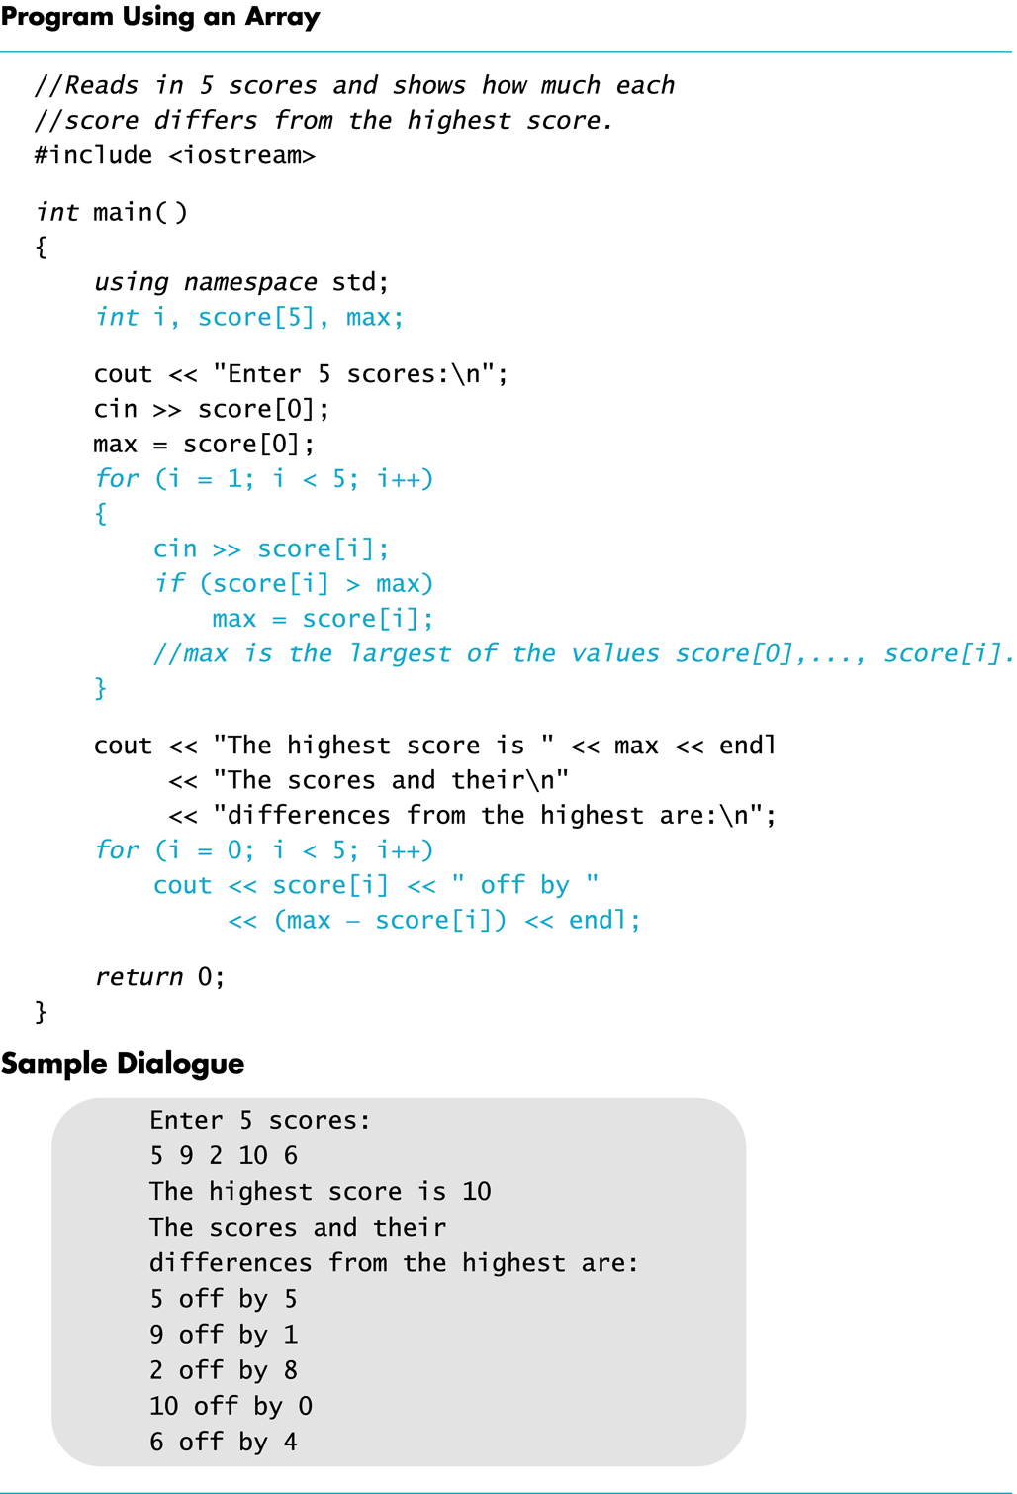
Display 7.1
Back
Next

Slide 75
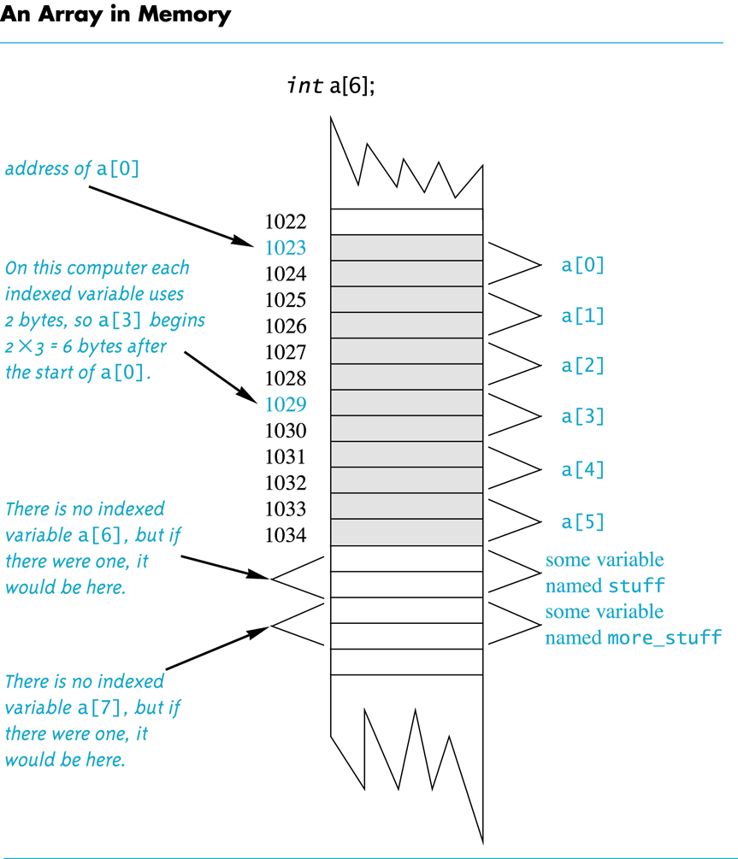
Display 7.2
Back
Next

Slide 76
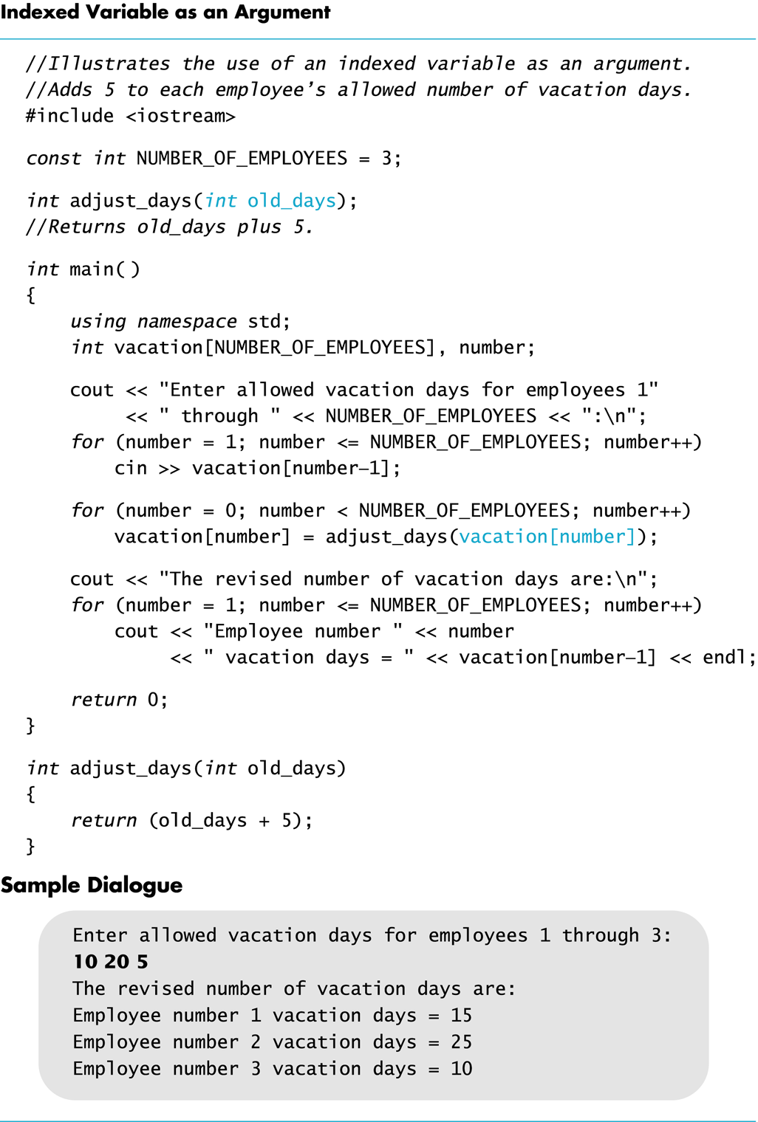
Display 7.3
Back
Next

Slide 77
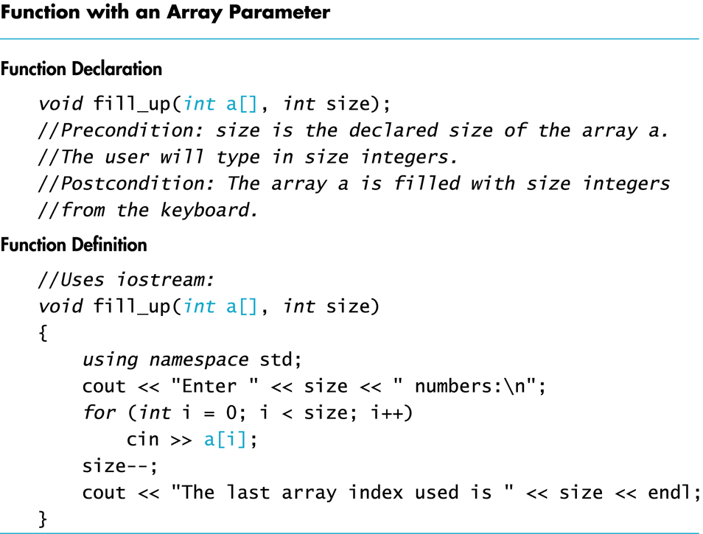
Display 7.4
Back
Next

Slide 78
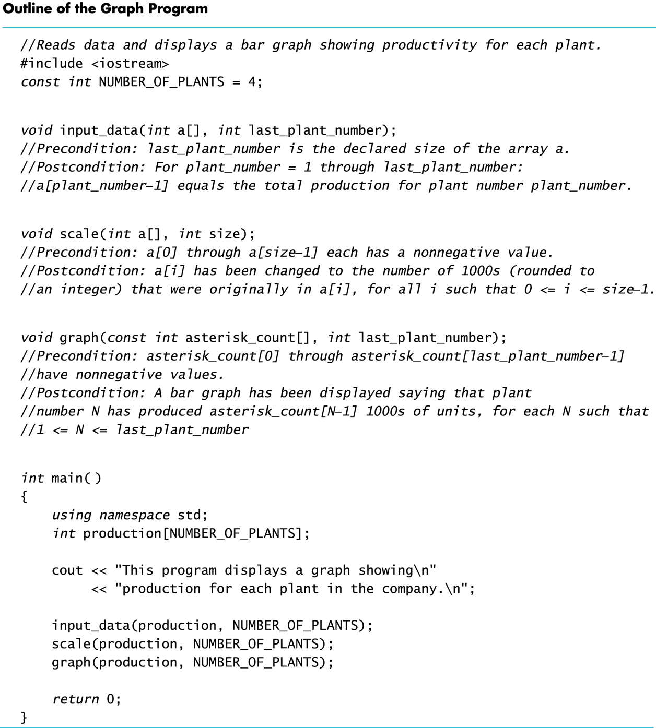
Display 7.5
Back
Next

Slide 79
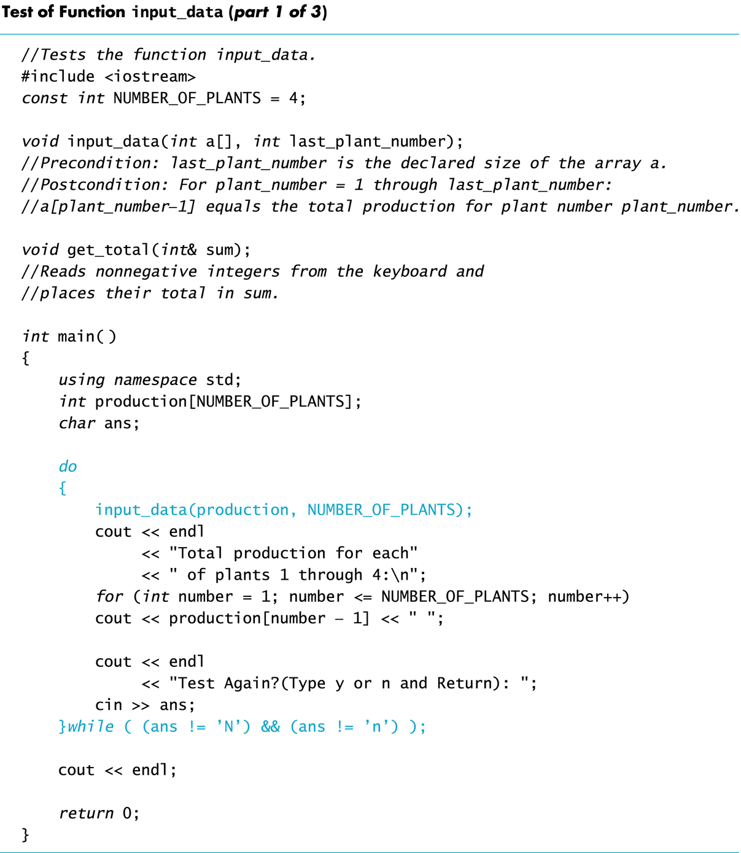
Display 7.6 (1/3)
Back
Next

Slide 80
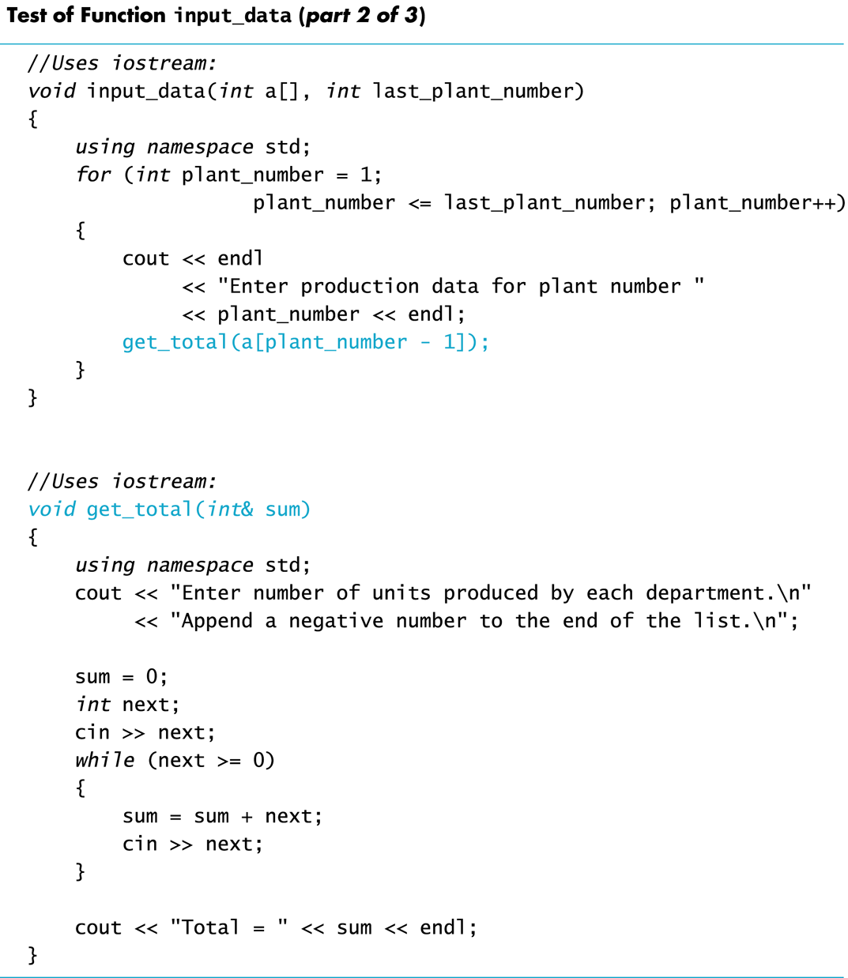
Display 7.6 (2/3)
Back
Next

Slide 81
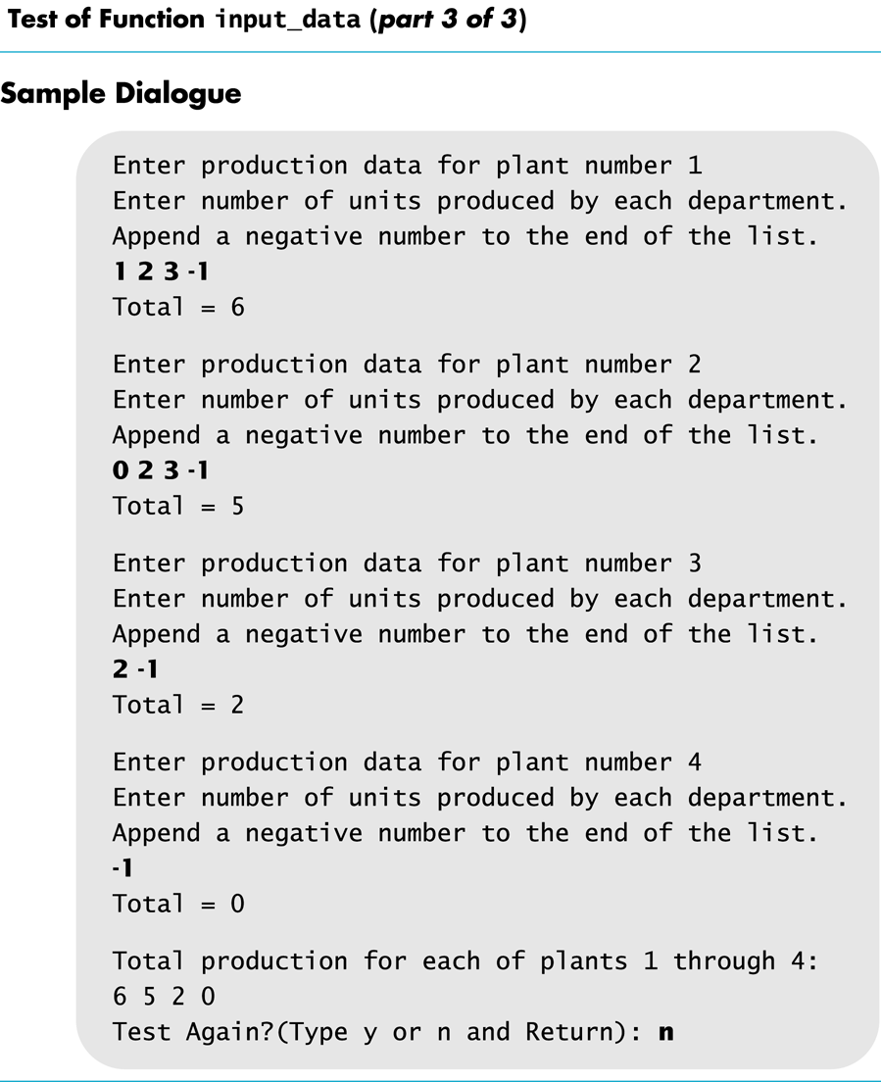
Display 7.6 (3/3)
Back
Next

Slide 82
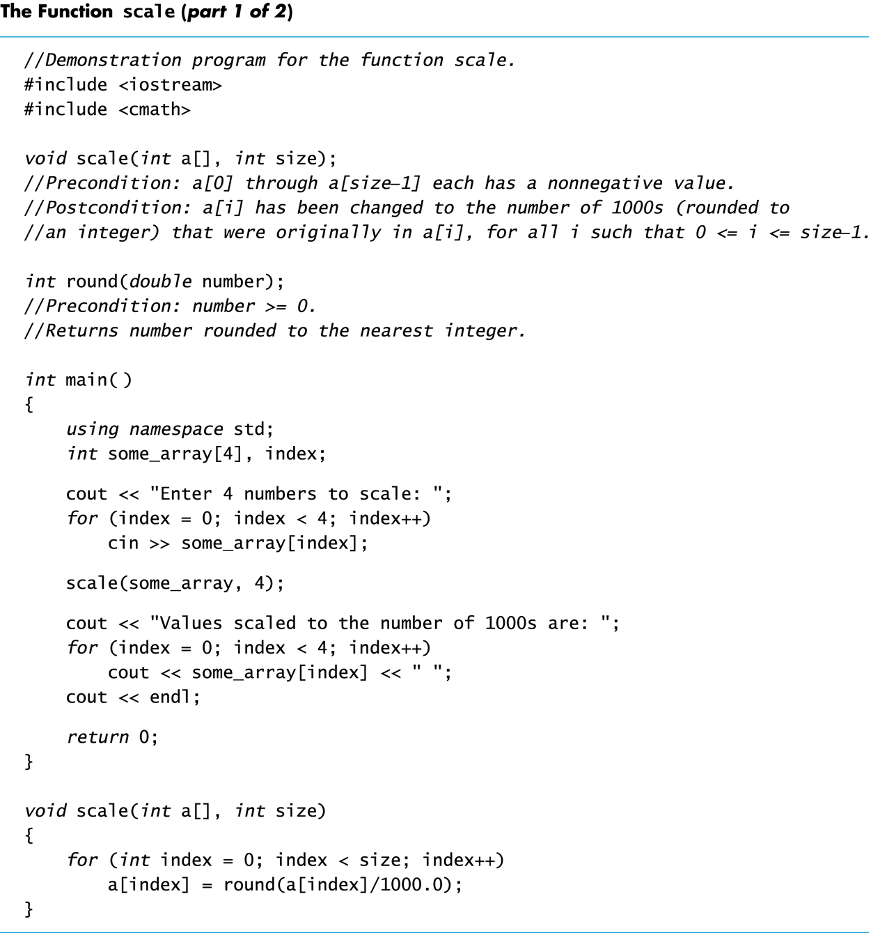
Display 7.7 (1/2)
Back
Next

Slide 83
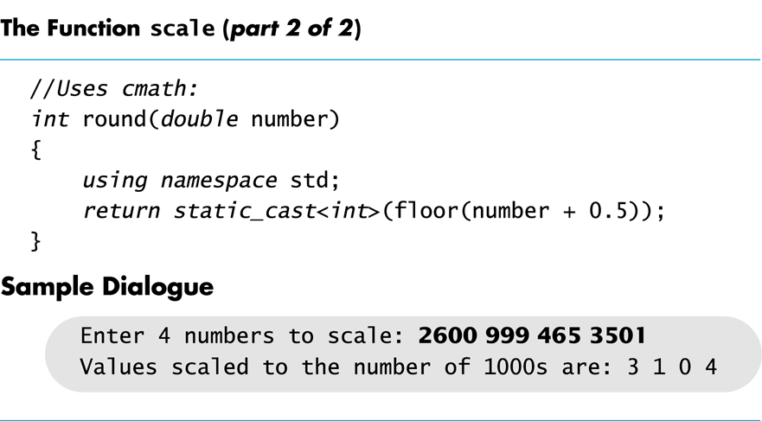
Display 7.7 (2/2)
Back
Next

Slide 84
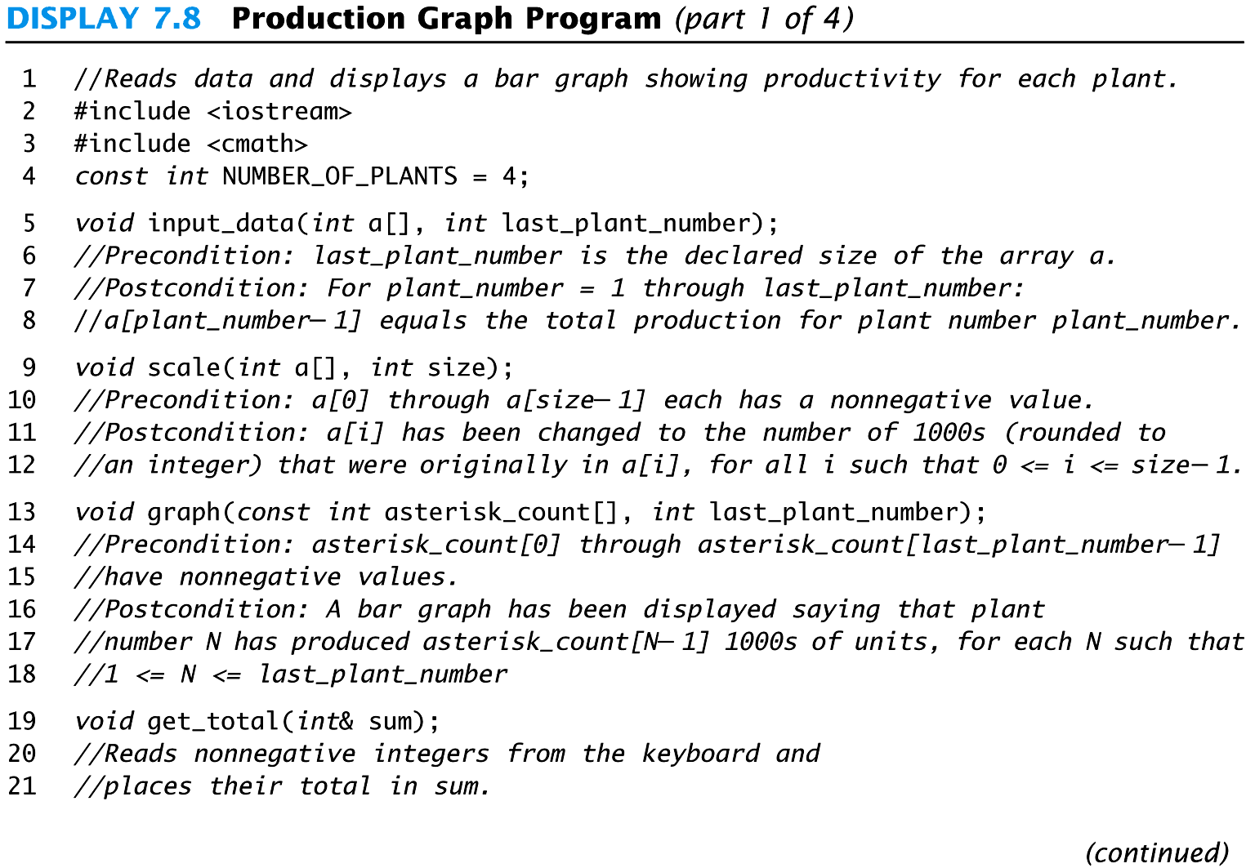
Display 7.8 (1/4)
Back
Next

Slide 85
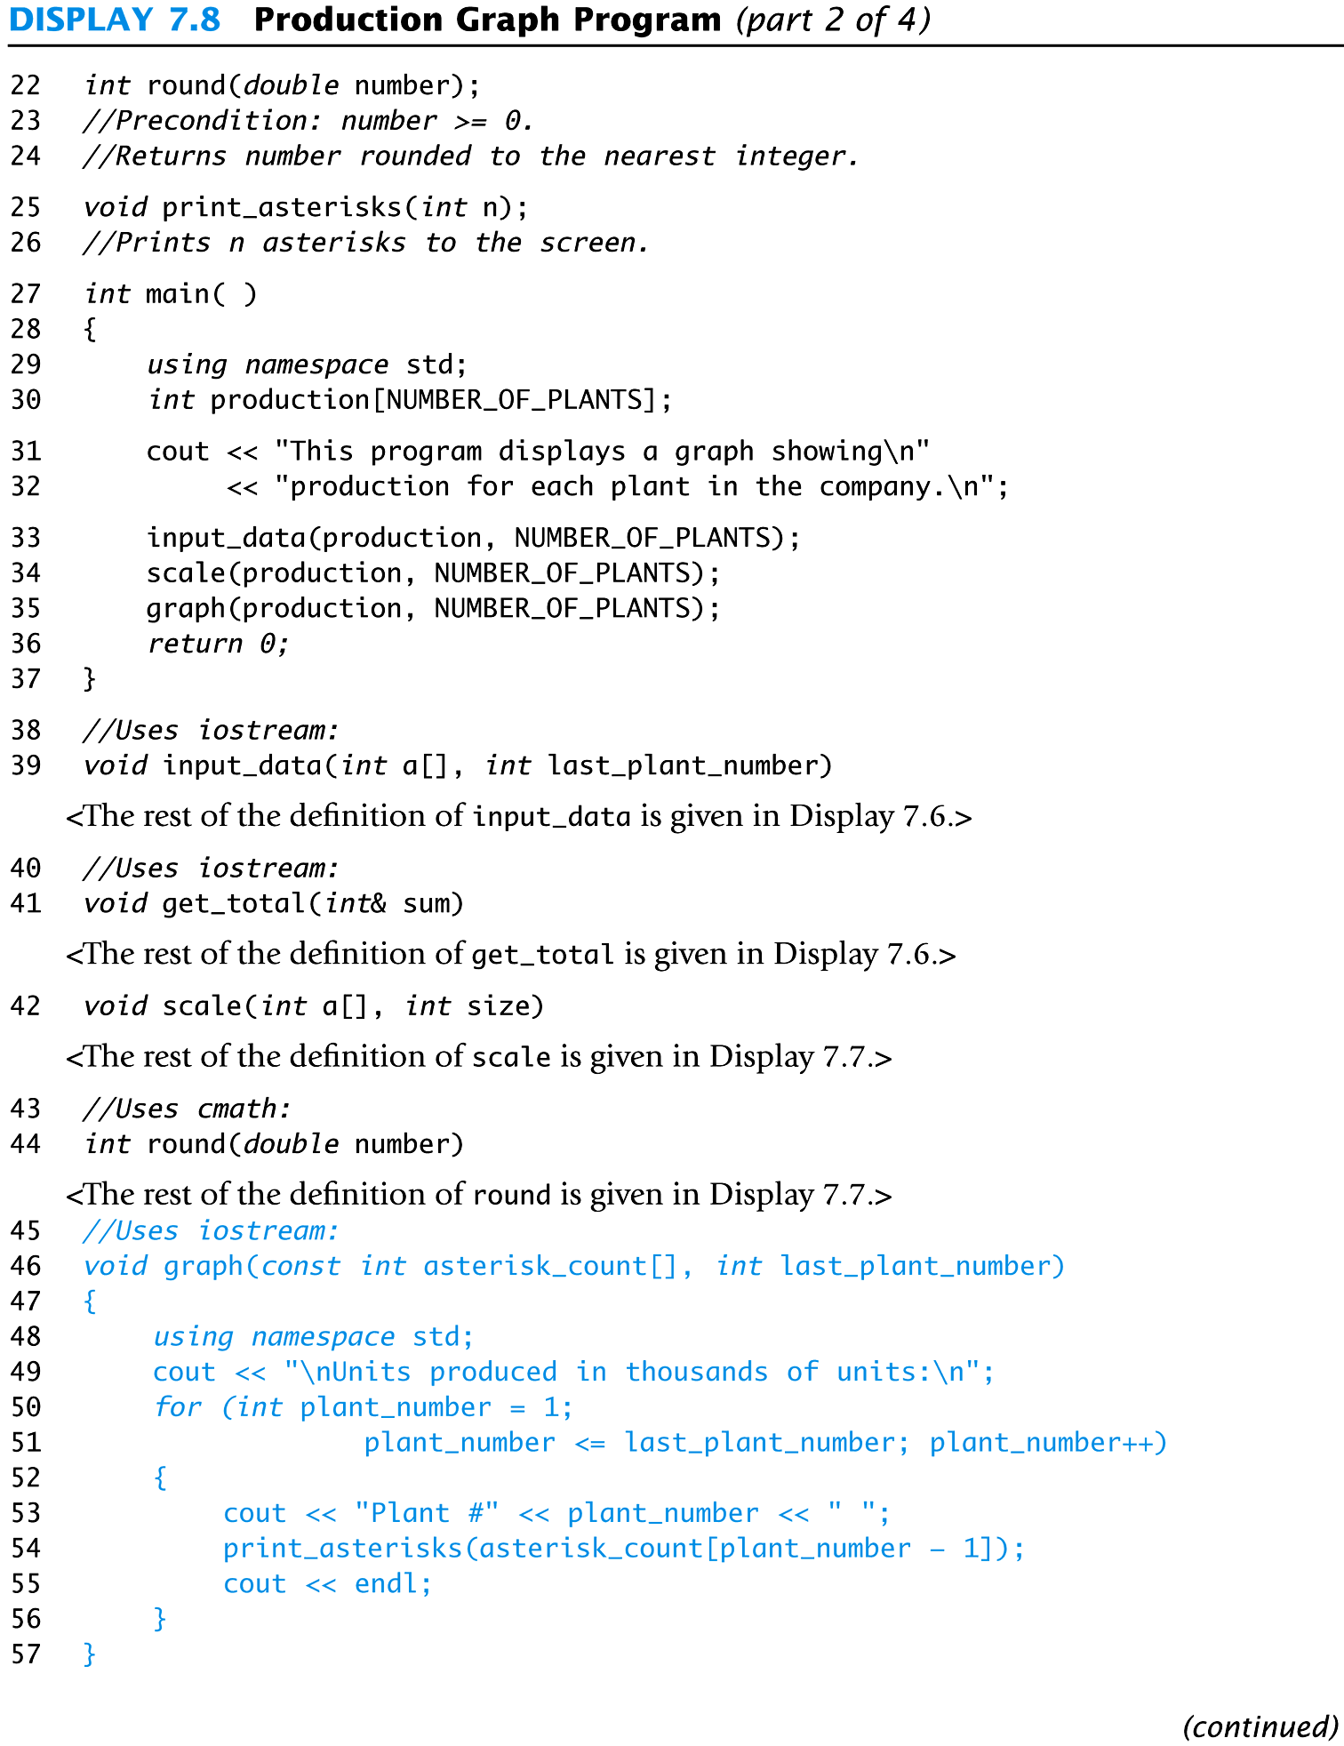
Display 7.8 (2/4)
Back
Next

Slide 86
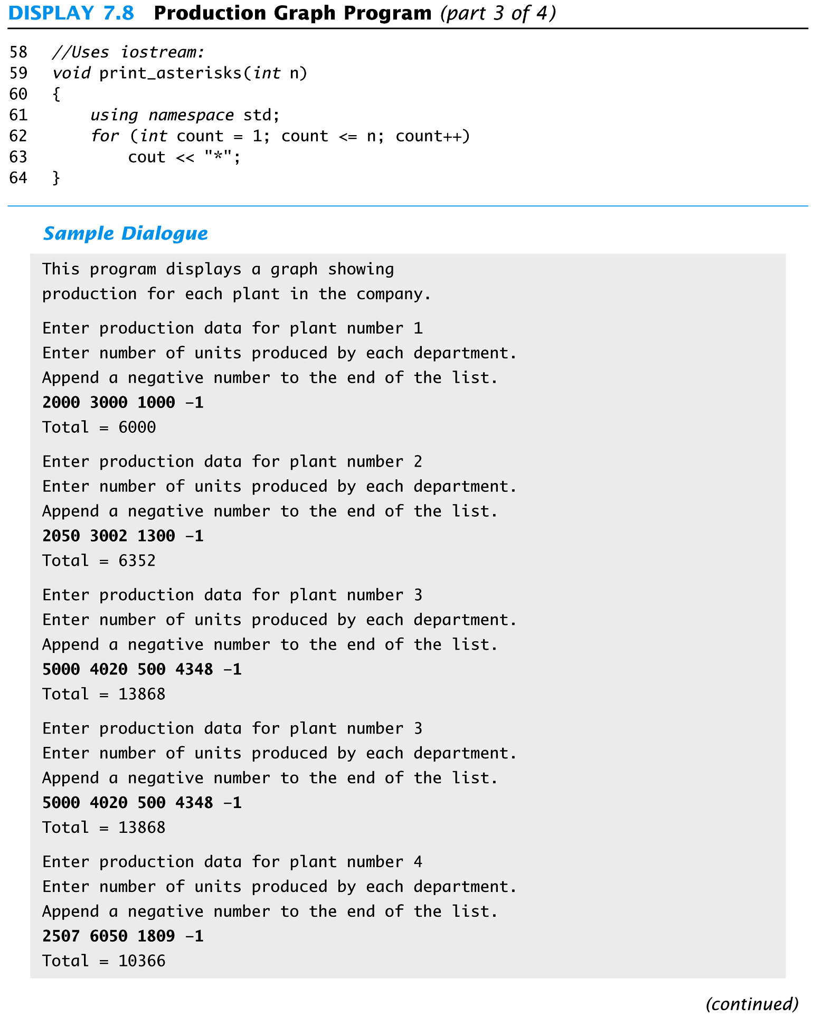
Display 7.8 (3/4)
Back
Next

Slide 87
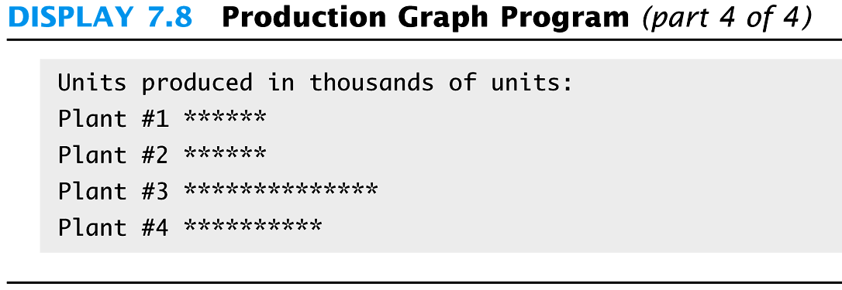
Display 7.8 (4/4)
Back
Next

Slide 88
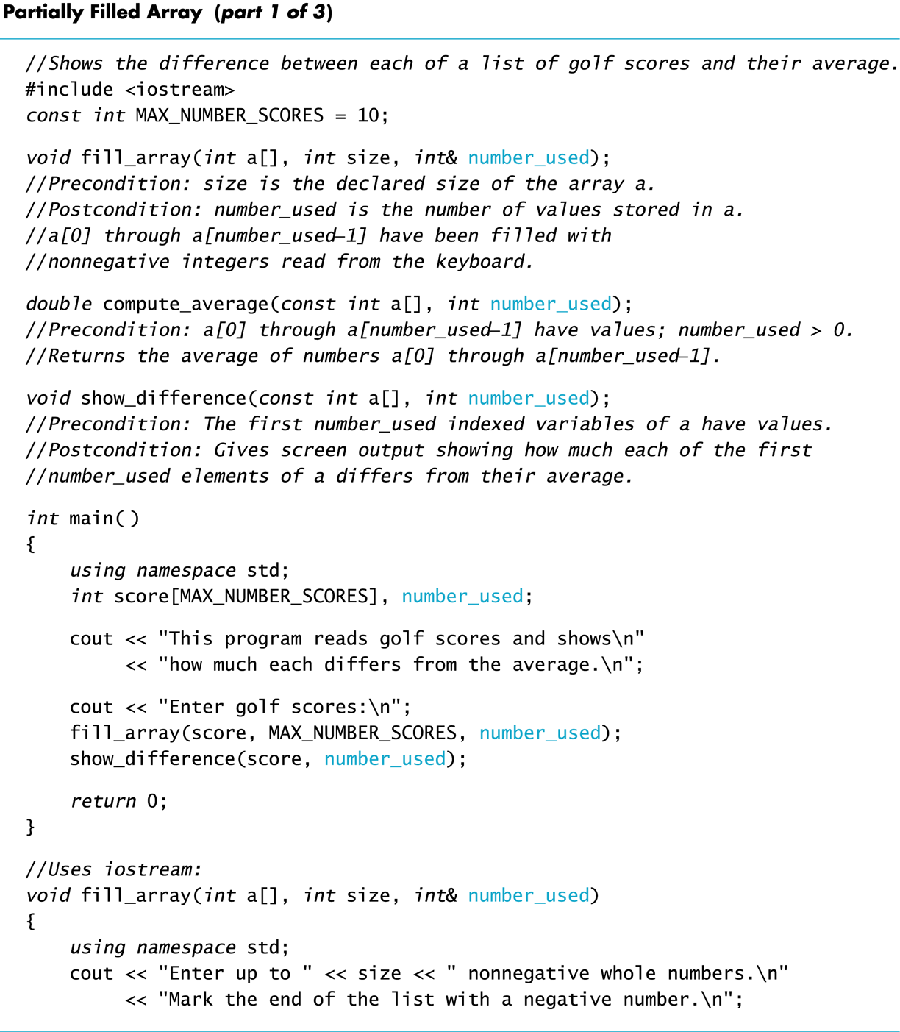
Display 7.9 (1/3)
Back
Next

Slide 89
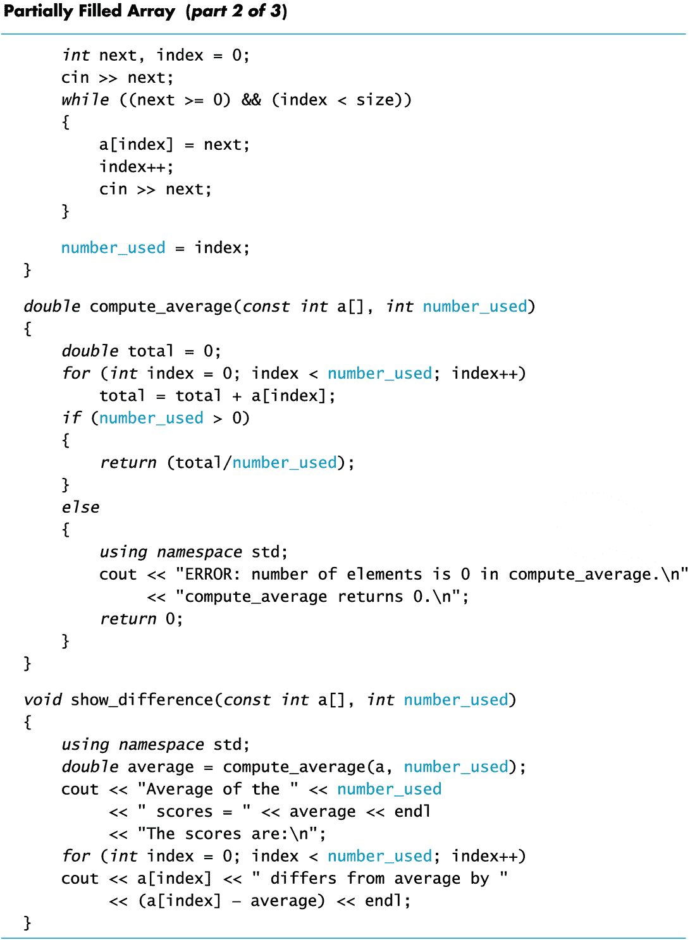
Display 7.9 (2/3)
Back
Next

Slide 90
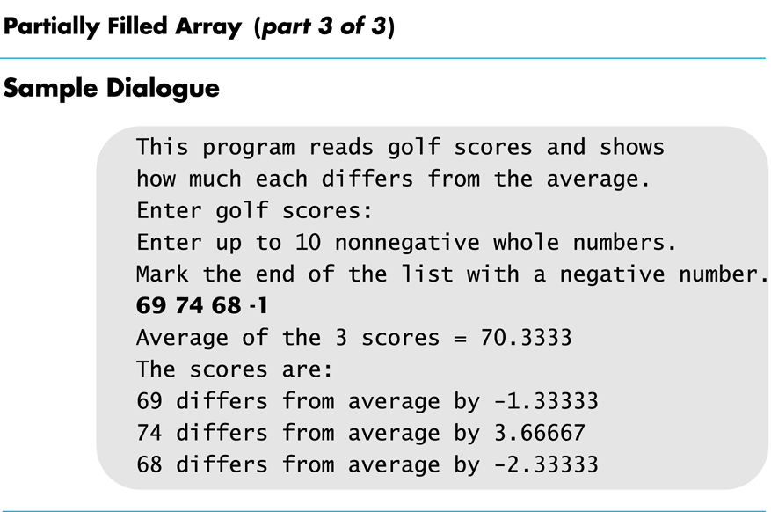
Display 7.9 (3/3)
Back
Next

Slide 91
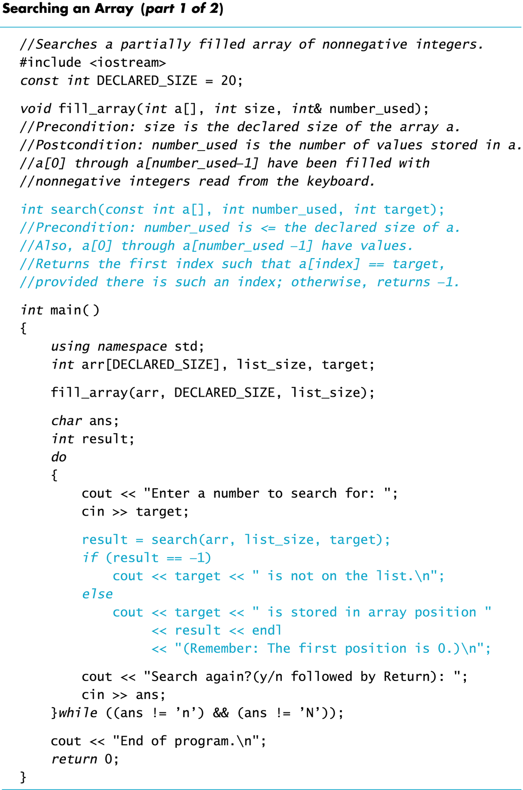
Display 7.10 (1/2)
Back
Next

Slide 92
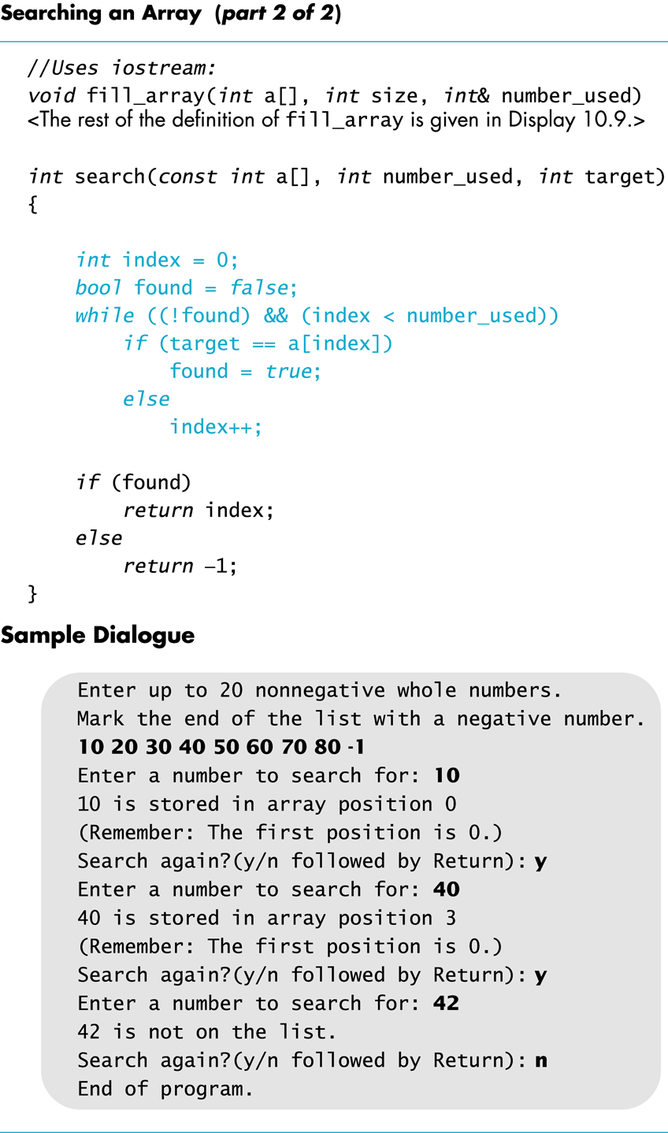
Display 7.10 (2/2)
Back
Next

Slide 93
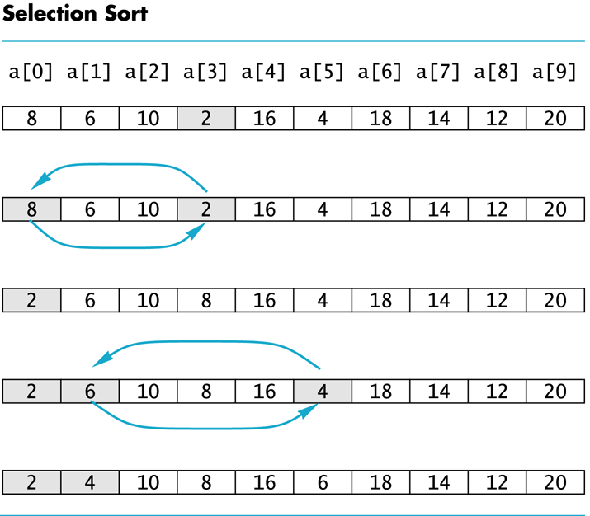
Display 7.11
Back
Next

Slide 94
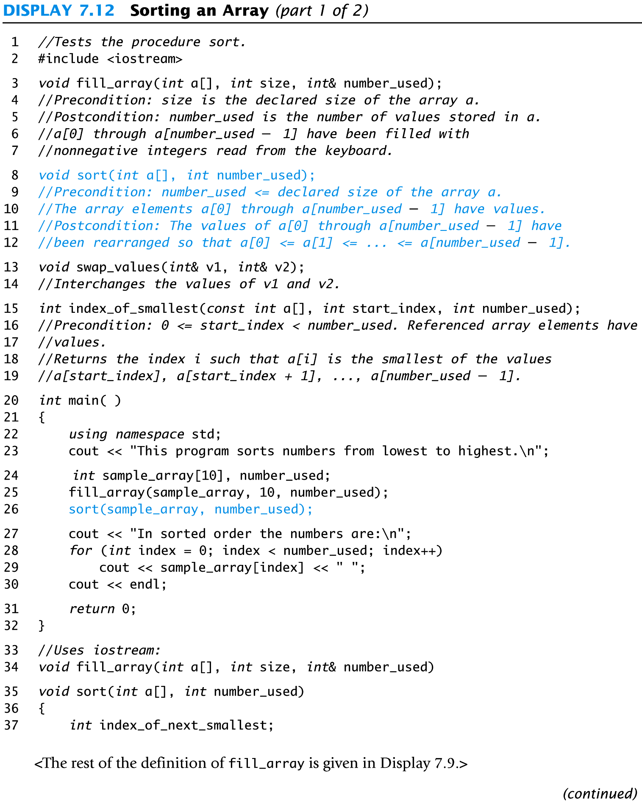
Display 7.12 (1/2)
Back
Next

Slide 95
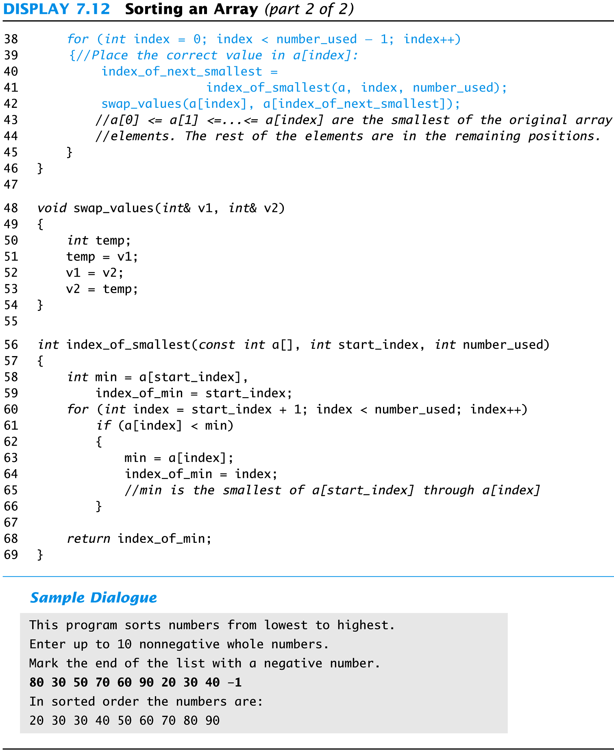
Display 7.12 (2/2)
Back
Next

Slide 96
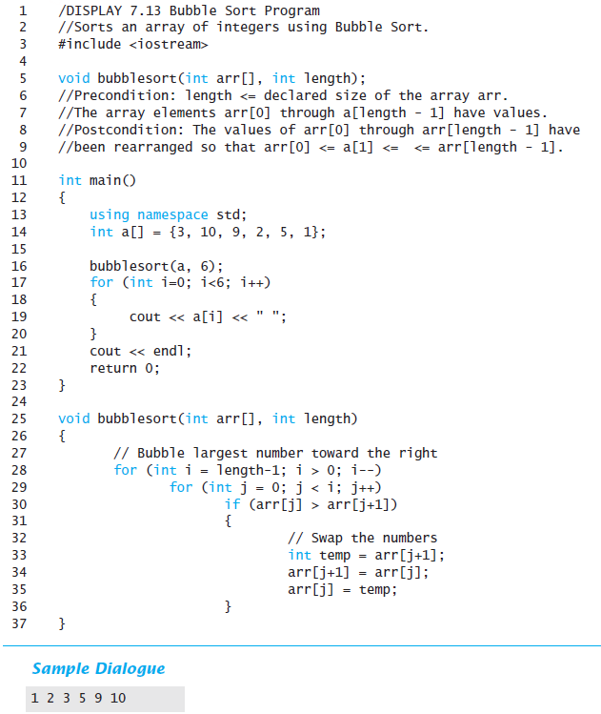
Display 7.13
Back
Next

Slide 97
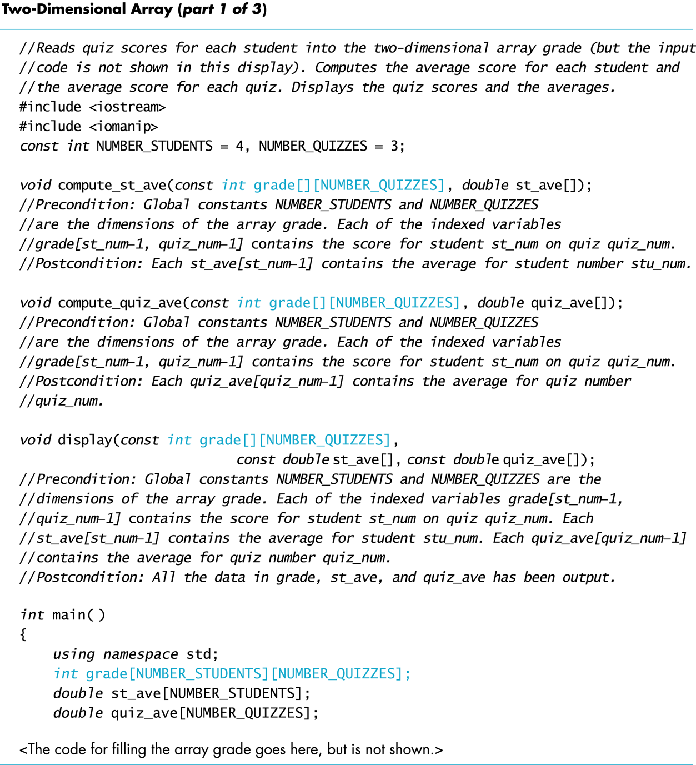
Display 7.14 (1/3)
Back
Next

Slide 98
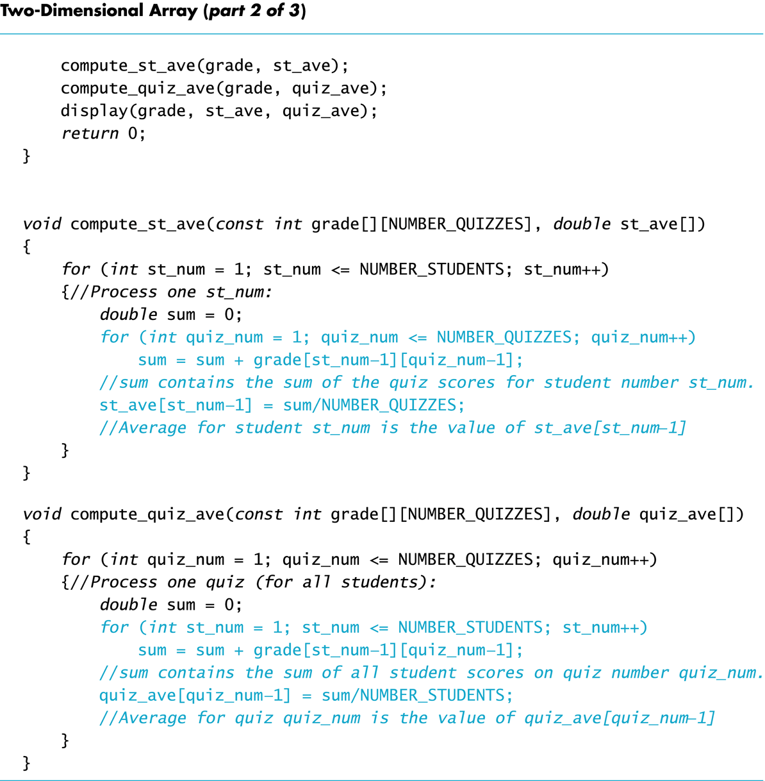
Display 7.14 (2/3)
Back
Next

Slide 99
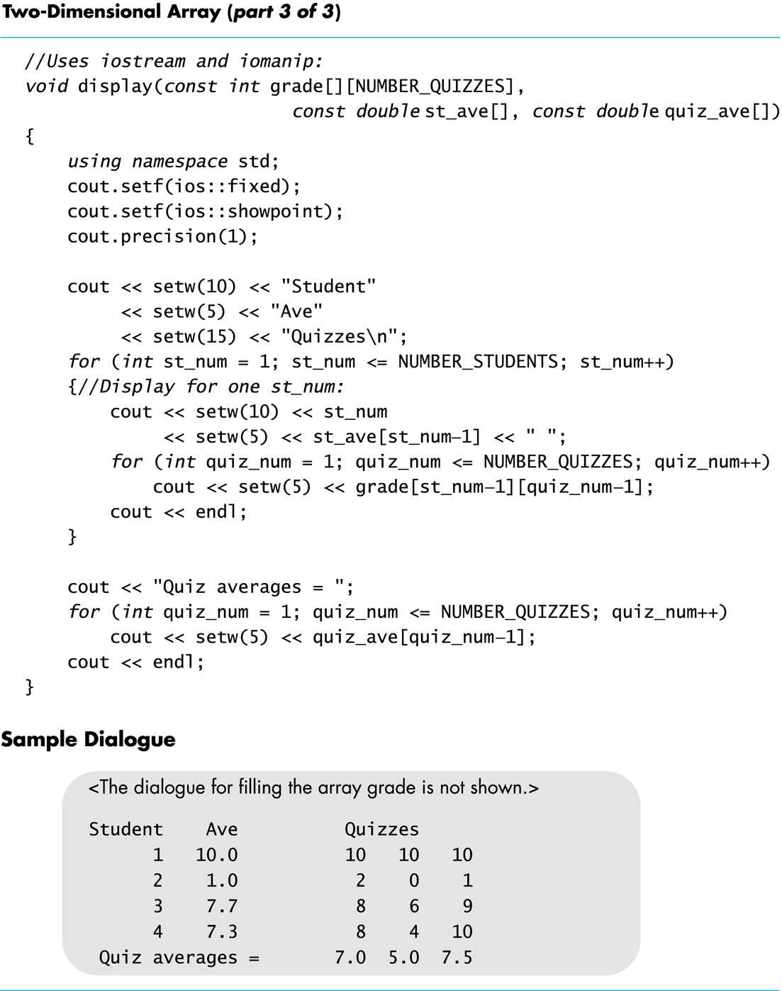
Display 7.14 (3/3)
Back
Next

Slide 100
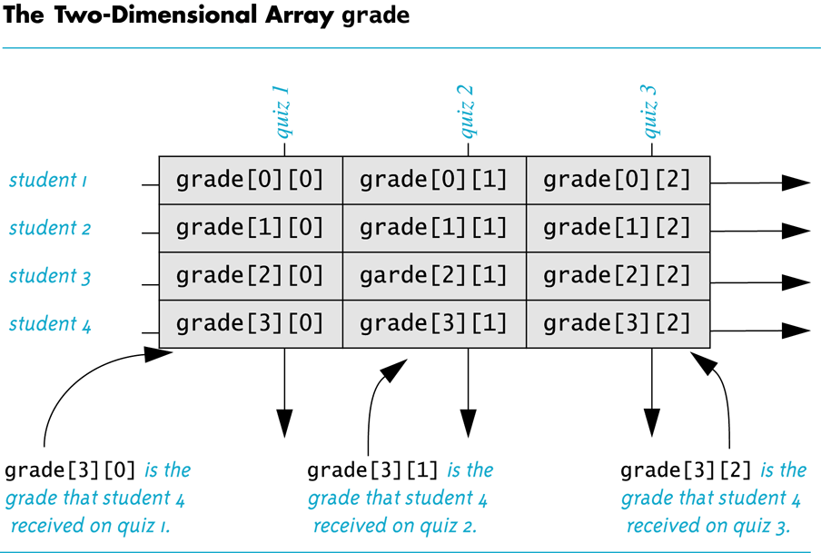
Display 7.15
Back
Next

Slide 101
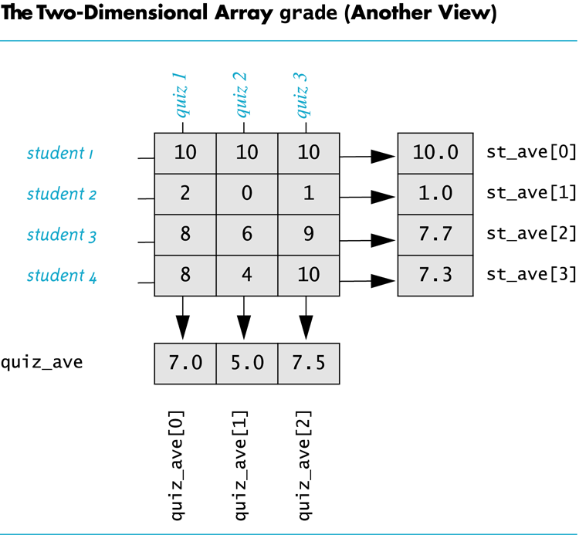
Display 7.16
Back
Next

